Slide 1

APSSDC INTERNSHIP PROJECT
AWS CLOUD
CareerPathAI
Design and Development of CareerPath AI Using AWS Cloud Services
Presented by
Tarun Sri Ram Nambada (23A81A61A8)
Vasavi Poppoppula (23A81A61B4)
Hari Venkata Satya Rajesh Desineedi (23A81A6184)
Hima Sree P (234M1A05B5)
Haritha Kamisetty (234M1A0568)

Slide 2
OVERVIEW
Agenda
01
02
Problem Statement
Solution Overview
Challenges in career guidance and resume management
Cloud-based approach to career recommendations
03
04
Key Features
AWS Services Used
Core capabilities of the CareerPathAI platform
Cloud infrastructure powering the application
05
06
System Architecture
Project Workflow
End-to-end technical design and data flow
Step-by-step user journey from registration to results
07
08
Future Enhancements
Conclusion
Planned features and scalability roadmap
Key takeaways and project outcomes

Slide 3

CHAPTER 1
Problem Statement
Many students are uncertain about which career path aligns with their current skill set, and existing tools offer little actionable guidance.
Skill Uncertainty
Limited Resume Guidance
Students struggle to identify career paths that match their existing skills and interests.
Resumes are uploaded but users receive no feedback on missing skills or suitable roles.
No Centralized Platform
Manual & Time-Consuming
No secure, unified system stores resumes while delivering personalized career recommendations.
Traditional career guidance is manual, slow, and difficult to personalize at scale.

Slide 4

Chapter 2
Solution Overview
CareerPathAI is a cloud-based web application that helps users explore suitable career paths through secure, automated skill analysis.
This project does NOT use Machine Learning, AI models, or datasets. Career recommendations are generated by comparing extracted resume skills with predefined JSON job-role skill mappings.
Users register and log in securely via Amazon Cognito
Resumes are uploaded and stored securely in Amazon S3
Resume details are parsed to extract user skills
Extracted skills are compared with predefined JSON job-role skill sets
Missing skills are identified and a personalized learning roadmap is generated
Metadata is stored in Amazon DynamoDB
Backend built with Spring Boot, deployed via Docker on Amazon EC2

Slide 5









CHAPTER 3
Key Features
Secure Authentication
Resume Upload
Resume Parsing
User login and registration powered by Amazon Cognito
Secure file upload and storage in Amazon S3
Automated extraction of skills and details from resumes
Career Recommendation
Skill Gap Analysis
Learning Roadmap
Identifies missing skills for each target job role
Personalized step-by-step plan to close skill gaps
Matching skills to predefined JSON job-role skill sets
Resume History
Dashboard Statistics
Cloud Storage
Track and revisit previously uploaded resumes
Visual overview of skills, matches, and progress
Reliable, scalable storage on AWS infrastructure

Slide 6
CHAPTER 4
AWS Services Used
Service
Purpose
Amazon Cognito
User authentication and secure login management
Amazon S3
Secure resume file storage and retrieval
Amazon DynamoDB
Stores resume metadata and user session data
Amazon EC2
Application hosting and compute infrastructure
AWS IAM
Secure access management and permission control
Docker
Containerized deployment of backend services
GitHub
Source code version control and collaboration

Slide 7
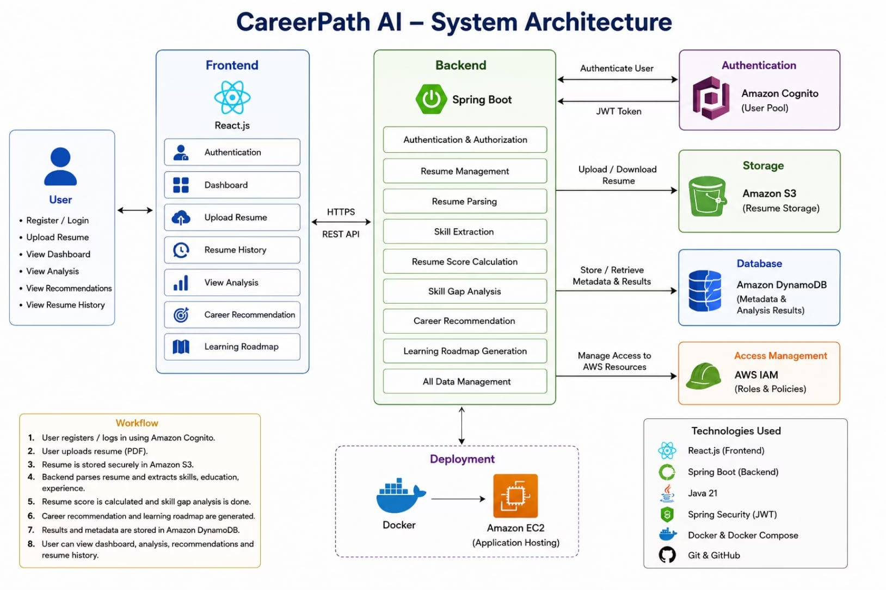
CHAPTER 5
System Architecture
The architecture follows a layered design: a React frontend communicates with a Spring Boot REST API hosted on Docker containers running on Amazon EC2.
Amazon Cognito handles authentication, while Amazon S3 stores resume files and DynamoDB persists metadata. A Skill Matching Engine compares parsed skills against JSON job-role files to generate career recommendations and learning roadmaps.
No AI, ML models, or datasets are used. Matching is performed entirely via predefined JSON skill mappings.

Slide 8

CHAPTER 6
Project Workflow
Upload Resume
User Auth
Parse & Compare
Recommend & Store
Each phase builds on the previous one, moving from authentication through resume processing to personalized career output.

Slide 9


CHAPTER 7
Future Enhancements
Expand Job Roles
Resume Scoring
Interview Prep
Certification Recommendations
Integrate automated resume scoring for quality assessment
Add an interview preparation module with practice resources
Add more job roles and increase the number of supported industries
Suggest relevant certifications based on identified skill gaps
Enhanced Analytics
Custom Domain & HTTPS
Optional AI Integration
Improve dashboard analytics with deeper insights and trends
Deploy with a custom domain and secure HTTPS configuration
Future versions may explore AI-based recommendation capabilities

Slide 10
CONCLUSION
Conclusion
CareerPathAI delivers a secure, cloud-based platform for career guidance and resume management. AWS services ensure scalability, reliability, and secure storage, while skill matching via predefined JSON files provides simple yet effective career recommendations.
Secure & Scalable
Practical Full-Stack
Effective Guidance
AWS-powered infrastructure with Cognito, S3, and DynamoDB
Demonstrates Java Full Stack and AWS in a real-world solution
JSON-based skill matching delivers actionable career roadmaps
Thank You

